Slide 1
Lecture 8: BattleField
Functions Details

Slide 2
Ques.
Write a python function, find_pairs_of_numbers() which accepts a list of positive integers with no repetitions and returns count of pairs of numbers in the list that adds up to n. The function should return 0, if no such pairs are found in the list.

Slide 3
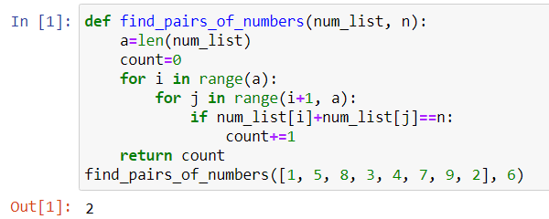
Ans.

Slide 4
Ques.
Given a string containing uppercase characters (A-Z), compress the string using Run Length encoding. Repetition of character has to be replaced by storing the length of that run.
Write a python function which performs the run length encoding for a given String and returns the run length encoded String.
Sample Input Expected Output
AAAABBBBCCCCCCCC 4A4B8C
AABCCA 2A1B2C1A

Slide 5
Ans.

Slide 6
Ques.
Write a function, check_palindrome() to check whether the given string is a palindrome or not. The function should return true if it is a palindrome else it should return false.

Slide 7
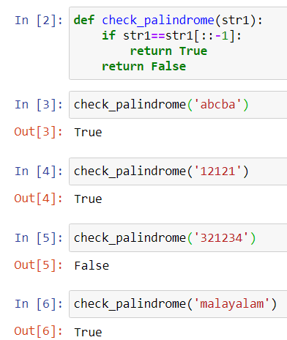
Ans.

Slide 8
Ques.
Write a python program to display all the common characters between two strings. Return -1 if there are no matching characters.

Slide 9
Ans.

